Slide 1
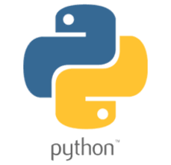
Basic Python Learning
AGENDA
What is Python?
Features of Python
Who uses python?
Starting off with Python basic
  Data Types
  Operations
  Flow Control
  Functions
  File Handling
Notes:
https://www.edureka.co/blog/python-tutorial/

Slide 2
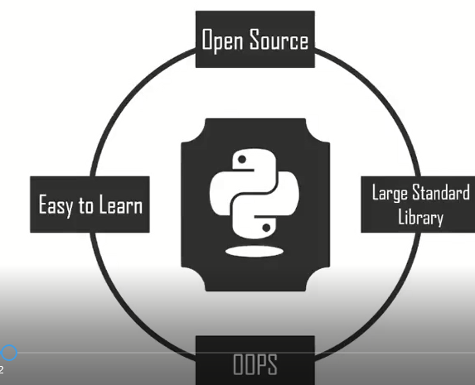
01. What is Python?
Created by Guido van Rossum during 1985- 1990.
Interpreted, interactive, object-oriented, and high-level programming language with easy syntax and dynamics semantics
Supports multiple programming paradigms, including Procedural, Object Oriented, and Functional programming languages.
design philosophy emphasizes code readability with the use of significant indentation.
is derived from many other languages, including ABC, Modula-3, C, C++, Algol-68, Smalltalk, Unix shell, and other scripting languages.

Slide 3
01. Python 2 Vs
Python 3
no | Python 2 | Python 3
1. | It does the approximation i.e it rounds up to the closest whole number in the integer division (7 divided by 2 returns 3) | It gives the accurate result (7 divided by 2 returns 3.5). Integer division in Python 3 becomes strikingly accurate, resulting in accurate values
2. | It’s syntax is difficult to understand | The syntax when compared is simpler and can be easily understood.
3. | The storage needs to define the Unicode string value with “u”. | The default storage of strings is Unicode.
4. | The value of the global variable will be changed whenever it will be used inside a for-loop. | The value of variables doesn’t change.
5. | Exceptions are enclosed in notations. | Exceptions are enclosed in parenthesis.
6. | The ordering comparison rules are comparatively complex. | The ordering comparisons rules are quite simple.
7. | In this version the xrange() is used for iterations. | It provides a Range() function to perform iterations.

Slide 4
02. Features of Python
Python is a very high-level programming language, yet it is effortless to learn.
Anyone can learn to code in Python in just a few hours or a few days.
Mastering Python and all its advanced concepts, packages, and modules might take some more time.
However, learning the basic Python syntax is very easy, as compared to other popular languages like C, C++, and Java.
1. Easy to Code

Slide 5
02. Features of Python
Python code looks like simple English words.
There is no use of semicolons or brackets, and the indentations define the code block.
You can tell what the code is supposed to do simply by looking at it.
Python is developed under an OSI-approved open-source license.
Hence, it is completely free to use, even for commercial purposes.
It can also be freely modified and re-distributed.
Python can be downloaded from the official Python website.
2. Easy to Read
3. Free and Open- Source

Slide 6
02. Features of Python
Python has an extensive standard library available for anyone to use.
This means that programmers don’t have to write their code for every single thing, unlike other programming languages.
There are libraries for image manipulation, databases, unit-testing, expressions, and a lot of other functionalities.
In addition to the standard library, there is also a growing collection of thousands of components, which are all available in the Python Package Index.
4. Robust Standard Library

Slide 7
02. Features of Python
When a programming language is interpreted, it means that the source code is executed line by line, and not all at once.
Programming languages such as C++ or Java are not interpreted, and hence need to be compiled first to run them.
There is no need to compile Python because it is processed at runtime by the interpreter.
5. Interpreted

Slide 8
02. Features of Python
Python is portable in the sense that the same code can be used on different machines.
Suppose you write Python code on a Mac.
If you want to run it on Windows or Linux later, you don’t have to make any changes to it.
As such, there is no need to write a program multiple times for several platforms.
6. Portable

Slide 9
02. Features of Python
A programming language is object-oriented if it focuses design around data and objects, rather than functions and logic.
On the contrary, a programming language is procedure-oriented if it focuses more on functions (code that can be reused).
One of the critical Python features is that it supports both object-oriented and procedure-oriented programming.
7. Object-Oriented and Procedure-Oriented

Slide 10
02. Features of Python
8. Extensible
9. Expressive
  A programming language is said to be extensible if it can be extended to other languages.
  Python code can also be written in other languages like C++, making it a highly extensible language.
  Python needs to use only a few lines of code to perform complex tasks.
  For example, to display Hello World, you simply need to type one line - print(“Hello World”).
  Other languages like Java or C would take up multiple lines to execute this.

Slide 11
02. Features of Python
One of the key aspects of any programming language is support for GUI or Graphical User Interface.
A user can easily interact with the software using a GUI.
Python offers various toolkits, such as Tkinter, wxPython and JPython, which allows for GUI's easy and fast development.
10. Support for GUI

Slide 12
02. Features of Python
Many programming languages need to declare the type of the variable before runtime.
With Python, the type of the variable can be decided during runtime.
This makes Python a dynamically typed language.
For example, if you have to assign an integer value 20 to a variable “x”, you don’t need to write int x = 20.
You just have to write x = 15.
11. Dynamically Typed

Slide 13
02. Features of Python
Python is a high-level programming language because programmers don’t need to remember the system architecture, nor do they have to manage the memory.
This makes it super programmer-friendly and is one of the key features of Python.
12. High-level Language

Slide 14
02. Features of Python
Python can be used to develop both desktop and web apps and complex scientific and numerical applications.
Python's data analysis features help you create custom big data solutions without so much time and effort.
You can also use Python data visualization libraries and APIs to present data in a more appealing way.
Several advanced software developers use Python to accomplish high-end AI and natural language processing tasks.
13. Simplify Complex Software Development

Slide 15
02. Features of Python
Python contains several advanced programming features such as generators (used to create iterators with a different approach than most other languages) and list comprehensions (used to create new lists from other iterable).
Python also has automatic memory management eliminating the need to manually allocate and free memory in the code.
14. Other Advanced Programming Features

Slide 16


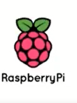





a
03. Who Uses Python?

Slide 17
04. Applications of Python
Data Science & Machine Learning
Web Development
Game Development
Software Development
Desktop GUI
Enterprise Applications
3D CAD Applications
Artificial Intelligence
Desktop Application
Automation
Data Wrangling, Exploration And Visualization.

Slide 18
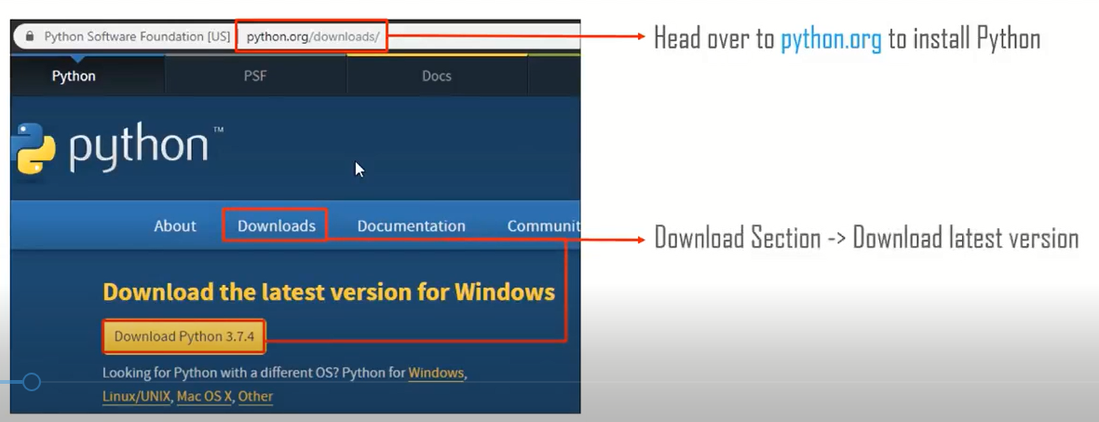
05. Starting off with Python Basics

Slide 19
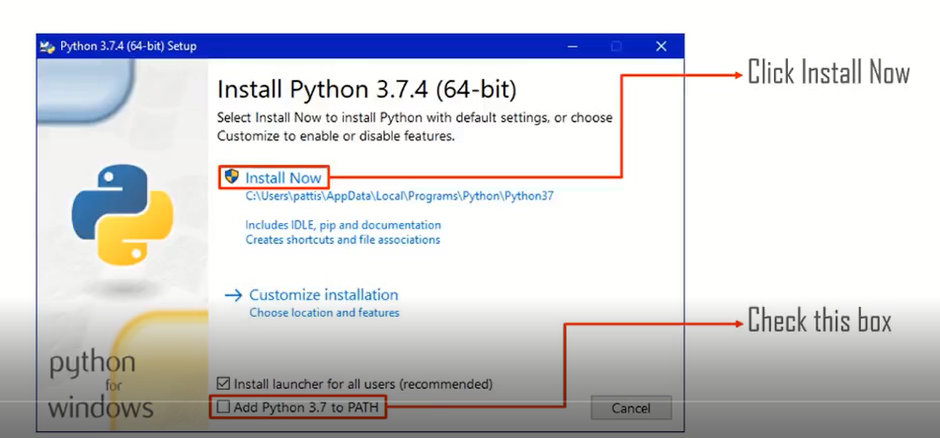
05. Installing Python on Windows

Slide 20
Python IDE
IDE typically provides code editor, compiler/ interpreter and debugger in one GUI (Graphical User Interface).
It encapsulates the entire process of code creation, compilation and testing which increases the productivity of developers.
A developer working with an IDE starts with a model, which the IDE translates into suitable code.
The IDE then debugs and tests the model-driven code, with a high level of automation.
Once the build is successful and properly tested, it can be deployed for further testing through the IDE or other tools outside of the IDE.

Slide 21
Which Python IDE?
Always keep the following points in mind while choosing the best IDE for Python:
  Level of expertise (beginner, professional) of the programmer
  The type of industry or sector where Python is being used
  Ability to buy commercial versions or stick to the free ones
  Kind of software being developed
  Need to integrate with other languages
  Once these points are decided upon, the programmer can easily select among the IDEs based on the given features.

Slide 22
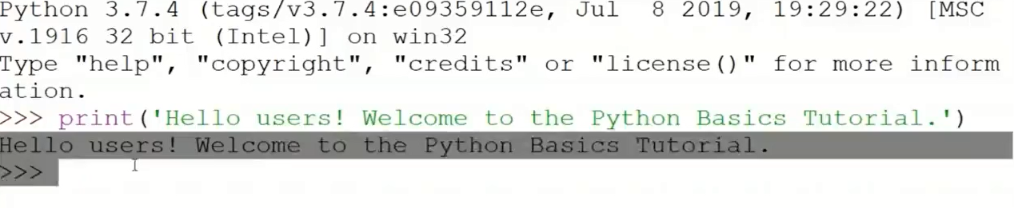
First Program with IDLE

Slide 23
PyCharm
Developed by Czech company JetBrains,
PyCharm is an IDE specific to Python.
PyCharm is a cross-platform IDE.
Therefore, users may download any of the Windows, Mac or Linux versions depending on their requirements.
Honestly, PyCharm is considered to be one of the best IDE for Python and justifiably the most widely used.

Slide 24
PyCharm features
PyCharm provides additional features like:
Specialized project views allowing quick switching between files
Facilitates Web Development along with Django, Flask, and web2py
PyCharm is equipped with more than 1000 plug-ins, so programmers can write their own plug-ins to extend its features
It provides two versions for download, the Community version which is free and the paid Professional version.
Programmers can download the corresponding versions as per their requirements.

Slide 25
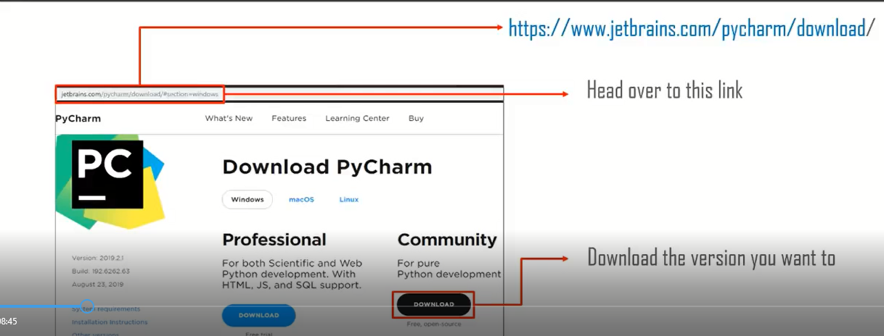
Downloading PyCharm
Go to
www.jetbrains.com/pycharm/download/#section=windows
Here, the community version is free, but for the professional version, you need to buy the license.
I will be working on the PyCharm community version.

Slide 26
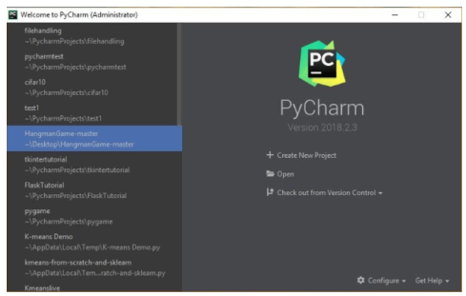
PyCharm Community Edition
Let us begin by creating a new project.
PyCharm greets you with the following image as soon as you open it:

Slide 27
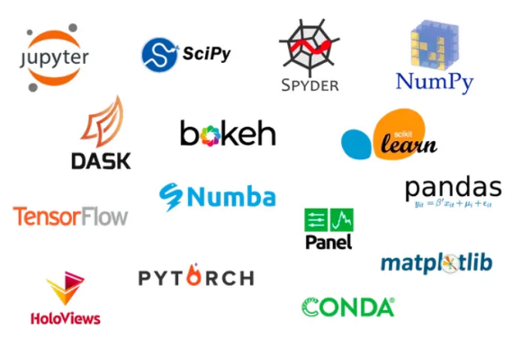
Anaconda
Anaconda Repository
Our repository features over 8,000 open-source data science and machine learning packages,
Anaconda-built and compiled for all major operating systems and architectures.

Slide 28
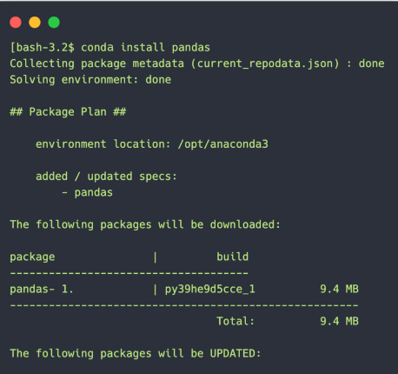
Conda
Conda is an open-source package and environment management system that runs on Windows, macOS, and Linux. Conda quickly installs, runs, and updates packages and their dependencies.
It also easily creates, saves, loads, and switches between environments on your local computer.
It was created for Python programs, but it can package and distribute software for any language.

Slide 29
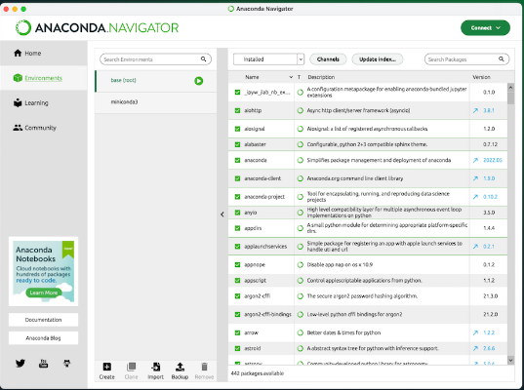
Anaconda Navigator
Our desktop application lets you easily manage integrated applications, packages, and environments without using the command line.

Slide 30
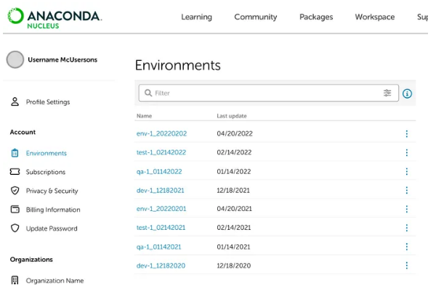
Cloud Environment Backup
Connect Anaconda Navigator to our community portal, Anaconda Cloud, to securely store your local environments in the cloud.

Slide 31
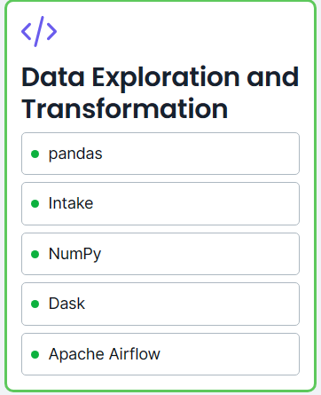
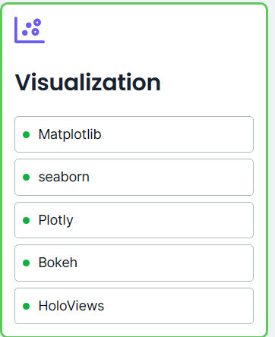
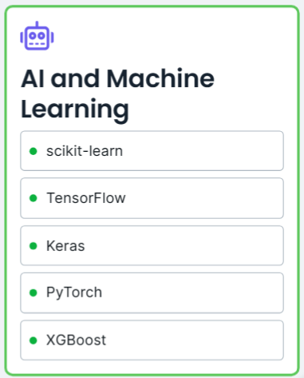
Powered by the most recommended and trusted open-source packages

Slide 32
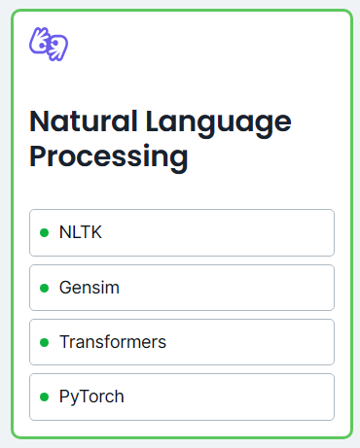
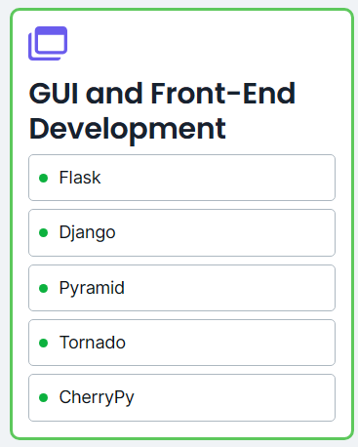
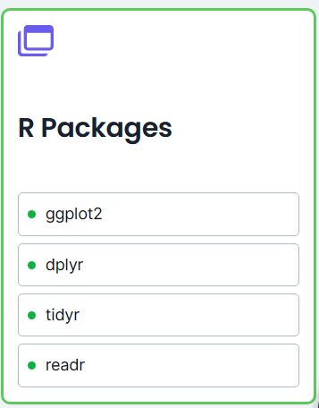
Powered by the most recommended and trusted open-source packages…

Slide 33
Jupyter Notebooks are a powerful way to write and iterate on your Python code for data analysis.
Jupyter Notebook is built off of IPython and the Kernel runs the computations and communicates with the Jupyter Notebook front-end interface.
Jupyter Notebook is an open-source web application that allows you to create and share documents that contain live code, equations, visualizations and narrative text.
It is used for data cleaning and transformation, numerical simulation, statistical modeling, data visualization, machine learning, and much more.
Jupyter Notebook

Slide 34
Python Popular libraries:
Tensorflow:
  It is specially used for developing and training highly efficient Machine Learning and Deep Learning models,
NumPy:
  This library is utilized in adding support for large, multi-dimensional arrays and matrices, accompanied by a large collection of high-level mathematical functions to operate on these arrays.
Pandas:
  It’s a software library specifically made for the Python programming language for the purpose of data analysis and manipulation.
Keras:
  It is a software library that is open-source & allows a Python interface for artificial neural networks.
Matplotlib:
  It is a library used for plotting in Python and its numerical mathematics extension NumPy.

Slide 35
Python Comments
Programmer-coherent statements, that describe what a block of code means.
They get very useful when you are writing large codes.
It’s practically inhuman to remember the names of every variable when you have a hundred-page program or so.
Therefore, making use of comments will make it very easy for you, or someone else to read as well as modify the code.
Syntax
      #this is a singsingle-linement
      #line comment
      """this isThisocstring
      comment
      i hope it is clear
      """

Slide 36
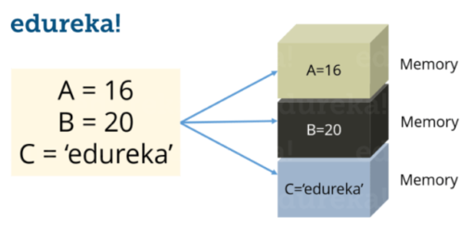
Python Variables
Variables are nothing but reserved memory locations to store values.
This means that when you create a variable you reserve some space in memory.
Note: In Python you don’t need to declare variables before using it, unlike other languages like Java, C etc.

Slide 37
Assigning values to a variable
Python variables do not need an explicit declaration to reserve memory space.
The declaration happens automatically when you assign a value to a variable.
The equal sign (=) is used to assign values to variables.
Consider the below example:
Syntax
  S = 10
  print(S)
This will assign value ‘10’ to the variable ‘S’ and will print it.

Slide 38

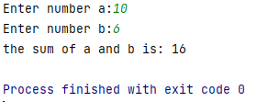
Exercise #1
Exercise #2
Write a python program to add two integer numbers
  a=int(input("Enter number a:"))
  b=int(input("Enter number b:"))
  print("the sum of a and b is:",(a+b))
  Output:
print("welcome to basic python tutorial!")
Output:

Slide 39
Exercise #2 cont’d
Error
a= input("Enter number a:")
b= input("Enter number b:")
print("the sum of a and b is:",(a+b))
Output:
Enter number a:2
Enter number b:3
the sum of a and b is: 23
Process finished with exit code 0

Slide 40
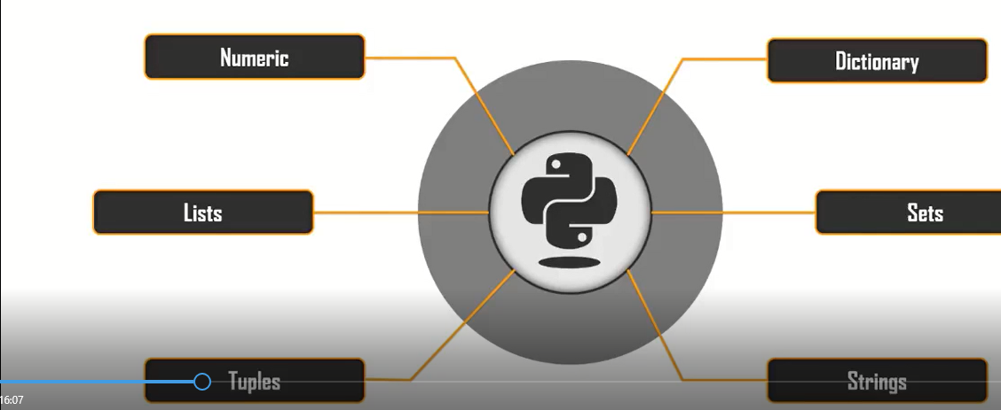
05. Data Type in Python
Basically there are six types of data type in python

Slide 41
Numeric Data Type
are used to store numerical values in the variables.
Numeric data types are not mutable.
Types | Examples
Integer | 1,5,356
Float Complex | 3.142 10+3j

Slide 42
Numeric Data
Example #1
a=10
b=-10
c=3.14
d=0.142
e=10+3j
f=6j
print(a+b,c-d,e-f,end='\n')
print(a-c,b-f,a*b,end='\n')
Example #2

Slide 43
Lists
Example #1:
#1. Initializing an empty list using the methods available
  my_list=[]
  print(my_list)
  my_list_2=list()
  print(my_list_2)
Lists are the same as arrays
Lists can have heterogenous data types in them
Lists are mutable.
Example:
a=[1,’hindi’,3.142,10+6j]

Slide 44
Lists
Example #3
#3.Accessing elements of the list
my_list=[1,2,3,’student','python']
print(my_list[:]) #Accessing all the elements at a
print(my_list[3]) #accessing the 3rd elements of the list
print(my_list[0:4]) #Accessing the elements from 1 to 3 and leaving index
print(my_list[::-1]) #Accessing elements in reverse order
print(my_list[3][2]) #Access particular element of the string student(u)
Example #2
#2.adding elements into the lists
  my_list=[1,2,3,’student','python']
  my_list_2=list([4,5,3.142,'fun','cool'])
  print(my_list)
  print(my_list_2)

Slide 45
Example #4: Adding elements to the list
my_list=[1,2,3,'edureka','python']
my_list_2=[4,5,3.142,'fun','cool']
my_list.append([555,12]) #Add passed parameters as a single element
print(my_list)
print(len(my_list))
my_list_2.extend([555,12]) #extending list by adding all the elements one by one
print(my_list_2)
print(len(my_list_2))
my_list.insert(1,'insert example') #insert passed parameter in place of index and extend list
print(my_list)
print(my_list+['just for example'])
print(my_list*2) #multiply
print(my_list)

Slide 46
List #5.Deleting elements from the list
  my_list=[1,2,3,'edureka','python']
  my_list_2=[4,5,3.142,'fun','cool']
  my_list_2.extend([555,12,'example’]) #extending list by adding all the elements one by one
  print(my_list_2)
  del my_list_2[5] #deletig using delete keyword
  print(my_list_2)
  my_list_2.remove('example') #remove the passed element if present else error
  a=my_list_2.pop(5) #deleted element can be retrieved
  print('popped Element:',a,'list remaining:',my_list_2)
  my_list_2.clear()
  print(my_list_2)

Slide 47
List: # 6. other functions
  # 6. other functions
    my_list=[1,2,3,'edureka','python']
    my_list_2=[4,5,3.142,'fun','cool']
    new=[5,4,12,45,3]
    print(len(my_list)) #find the length of the list
    print(my_list.index('edureka')) #finds index of the element
    print(my_list.count('edureka')) #finds count of times repeated in list
    print(sorted(new)) #sorts elements in the list but does not change original
    print(new)
    new.sort(reverse=True) #reverses list elements
    print(new)
    new_list=my_list.copy() #copies elements of list to the new list
    print(new_list)

Slide 48
A tuple is a collection of objects which ordered and immutable.
Tuples are sequences, just like lists.
Tuples cannot be changed unlike lists
Tuples use parentheses, whereas lists use square brackets.
Creating a tuple is as simple as putting different comma-separated values.
Optionally you can put these comma-separated values between parentheses also.
For example −
    tup1 = ('physics', 'chemistry', 1997, 2000);
    tup2 = (1, 2, 3, 4, 5 );
    tup3 = "a", "b", "c", "d";
Tuple

Slide 49
Tuple: Example
#2.Accessing elements of a tuple
  my_tuple=(1,2,3)
  my_tuple_2=('python','for', 'edureka')
  my_tuple_3=(1,2,3,['hindi','python'])
  print(my_tuple[0])
  print(my_tuple[:])
  print(my_tuple_3[3][1])
#1. initializing elements to the tuple
my_tuple=(1,2,3)
my_tuple_2=tuple(('python','for','edureka'))
print(my_tuple)
print(my_tuple_2)
my_tuple_3='example' , #add comma in the end if you want a tuple with single element, else if
print(type(my_tuple_3))

Slide 50
Tuple: Example…
#4.Elements in the tuple can be changed if the data type in the list is mutable
my_tuple_3=(1,2,3,['hindi','python'])
my_tuple_3[3][0]='English'
print(my_tuple_3)
'''
#5.tuple methods
my_tuple_3=(1,2,3,['hindi','python'])
print(my_tuple_3.count(2))
print(my_tuple_3.index(['hindi','python']))

Slide 51
Are used to hold key, values pairs
Mutable
Example: mydict={‘Name’:Akash’,’Sign’:’libra’}
Dictionary

Slide 52
Dictionary: Example
#1. Initialize the dictionary
my_dict={}
my_dict_2=dict()
print(my_dict)
print(my_dict_2)
#2. Initialize elements in the dictionary
my_dict={1:'python',2:'Java'}
my_dict_2=dict({1:'c++', 2:'rubby'})
print(my_dict)
print(my_dict_2)
#3.Accessing the element of the dictionary
  my_dict={'First':'python','Second':'java'}
  print(my_dict['First']) # get value by keys
  print(my_dict.get('Second'))

Slide 53
Dictionary: Example
5.Deleting elements from the dictionary
my_dict={'Firt':'python', 'second':'java','Third':'Rubby'}
print(my_dict)
a=my_dict.pop('Third') #Remove the key and return value
print('\nvalue:',a)
print('Dictionary:',my_dict)
b=my_dict.popitem() #Remove a key value pair at random and return them as a tuple
print('\nkey,value pair:',b)
print('Dictionary',my_dict)
my_dict.clear() #Used to clear all values in the dictionary
#You can use del keyword to delete the values too
#4.Adding and changing elements int the dictionary
my_dict={'Firt':'python', 'second':'java'}
print(my_dict)
my_dict['second']='C++' #change the value of key second
print(my_dict)
my_dict['Third']='Rubby' #add new key, value pair
print(my_dict)

Slide 54
Dictionary: Example
#6.Other functions
my_dict={'Firt':'python', 'second':'java','Third':'Rubby'}
print(my_dict.keys())
print(my_dict.values())
print(my_dict.items())
print(my_dict.get('First'))

Slide 55
Are un-ordered collection of unique elements
Sets are mutable
We not have key values
  Example: a={1,2,3,4,5}
Sets
SET: EXAMPLE
#1. creating the set
  my_set={1,2,3,4,4,5}
  print(my_set)
#2.Adding elements in sets
  my_set={1,2,3}
  my_set.add(4)
  print(my_set)

Slide 56
SET: Example
#4.Operators with sets
superset={1,2,3,4,5,6,7,8,9,10}
s1={1,2,3,4}
s2={3,4,5,6}
print(s1==s2) # if symmetric
print(s1!=s2) #if not symmetric
print(s1<=superset) #if s1 is subset of superset
print(s1<superset)
print(s1>=s2)
print(s1>s2)
#3.Other methods in the sets
my_set={1,2,3,4}
my_set_2={3,4,5,6}
print(my_set.union(my_set_2),'---------',my_set|my_set_2)
print(my_set.intersection(my_set_2),'------',my_set&my_set_2)
print(my_set.difference(my_set_2),'-----',my_set-my_set_2)
#print(my_set.symmetric_difference(my_set_2),'---',my_set)
my_set.clear()
print(my_set)
'''

Slide 57
Are a collection of characters
The are written with single( ‘ ‘) or double(“ ”)
Quotation marks
Strings are not mutable
Example:
String=“Welcome to python tutorial”
Strings Data Type

Slide 58
String: Example
#2.String splicing
my_str='welcome to the tutorial'
print(my_str[:]) #print all
print(my_str[2:10]) #print from index 2 until index 9 and skip 10
print(my_str[0:14:1]) #print from index 0 until 13 skipping 1 element
print(my_str[0:14:2]) #print from index 0 to 13 skipping 2 elements
print(my_str[::-1])
print(my_str[-7:-1])
'''
#1.creating a string
my_str='welcome to the tutorial'
my_str_2='This is my string'
print(my_str)
print(my_str_2)

Slide 59
String: Example
#3.other functions
my_str='welcome to the tutorial'
print(len(my_str)) #return length
print(my_str.count('t')) #return length of the string
print(my_str.lower()) #convert to lower case
print(my_str.upper()) #convert to upper case
print(my_str.find('l')) #returns index of the element found
print(my_str.partition('to')) #breaks the string into tuple for the parameter passsed
print(my_str.split(' ')) #split the string for the parameter passed
print(my_str.replace('welcome','hello, welcome'))

Slide 60
06. Operators in Python
01. Arithmetic Operators
Operators are constructs you use to manipulate data
Describes actions that need to be done
Derive information from data or manipulate them to obtain solutions
02.Assignment Operators
03. Comparison Operators
04. Logical Operators
05. Bitwise Operators
06.Identity Operators
07. Membership Operators

Slide 61
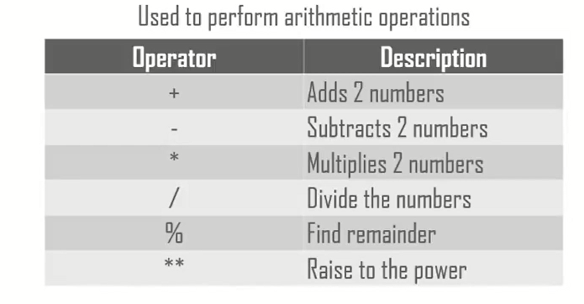
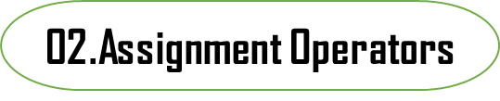
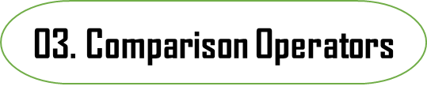
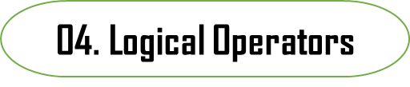
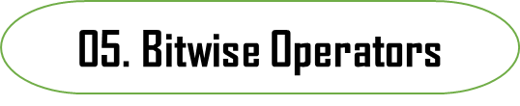
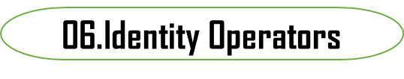
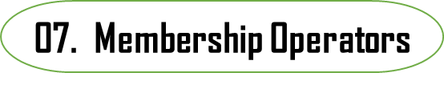
01. Arithmetic Operators
.

Slide 62
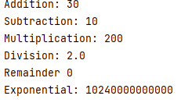
Example #1
01. Arithmetic Operators
a=20
b=10
print('Addition:',a+b)
print('Subtraction:',a-b)
print('Multiplication:',a*b)
print('Division:',a/b)
print('Exponential:',a**b)
Output:

Slide 63
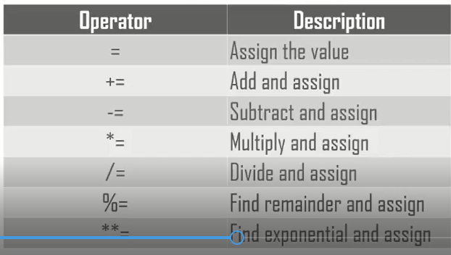
02. Assignment Operators
.
01. Arithmetic Operators
Used to assign values to variables
03. Comparison Operators
04. Logical Operators
05. Bitwise Operators
06.Identity Operators
07. Membership Operators

Slide 64
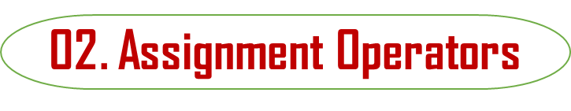
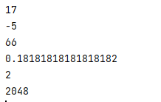
Example #1
a=11
add,sub,mul,div,rem,expo=6,6,6,2,2,2
add+=a
print(add)
sub-=a
print(sub)
mul*=a
print(mul)
div/=a Output
print(div)
rem%=a
print(rem)
expo**=a
print(expo)

Slide 65
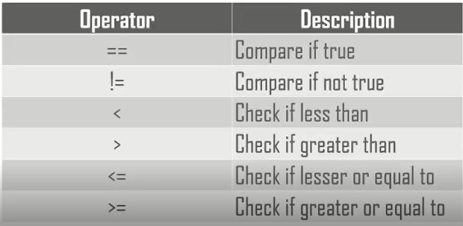
03. Comparison Operators
01. Arithmetic Operators
.
Used to compare values
04. Logical Operators
05. Bitwise Operators
06.Identity Operators
07. Membership Operators

Slide 66
Example #1
03. Comparison Operators
Output:
    False
    True
    False
    True
    False
    True
a=5
b=10
print(a==b)
print(a!=b)
print(a>b)
print(a<b)
print(a>=b)
print(a<=b)

Slide 67
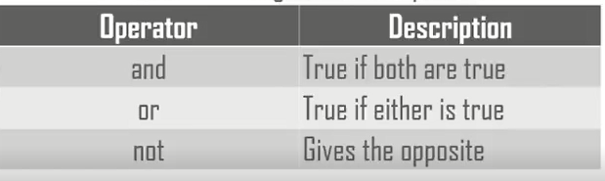
04. Logical Operators
.
01. Arithmetic Operators
Used to obtain logic from the operands
03. Comparison Operators
05. Bitwise Operators
06.Identity Operators
07. Membership Operators

Slide 68
Example #1
04. Logical Operators
a=5
b=0
print(a and b) # True if both are true
print(a or b) # True if either one has true
print(not a) # Returns opposite values
print(not b) # Returns opposite values
Output:
  0
  5
  False
  True

Slide 69
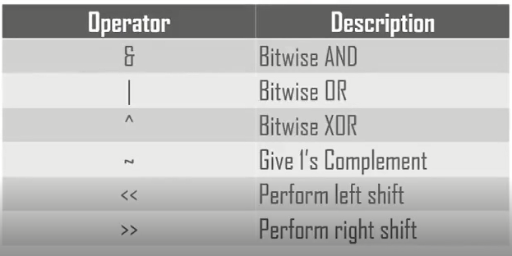
05. Bitwise Operators
01. Arithmetic Operators
.
Used to manipulate the bits of the value directly.
03. Comparison Operators
04. Logical Operators
06.Identity Operators
07. Membership Operators

Slide 70
Example #1
05. Bitwise Operators
a=5
b=6
print(a&b) # perform bit by bit and operation
print(a|b) # perform bit by bit and operation
print(~a) #perform the compliment
print(a<<b) #perform left shift operation, shifting by 1equal to multiplying by2
print(a>>b) #perform right shift operation, shifting by 1equal to multiplying by2
Output:
    4
    7
    -6
    320
    0

Slide 71
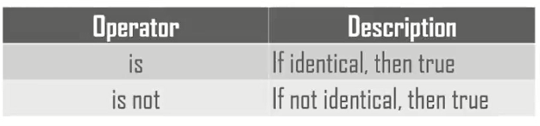
06. Identity Operators
01. Arithmetic Operators
.
Check whether values are identical or not
03. Comparison Operators
04. Logical Operators
05. Bitwise Operators
07. Membership Operators

Slide 72
Example #1
06. Identity Operators
a=[1,2,3]
b=[2,3,4]
print(a is b) #True if a and b are equal
print(a is not b) #True if a and b are not equal
Output:
    False
    True

Slide 73
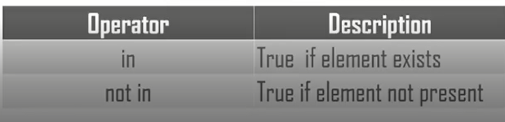
07. Membership Operators
01. Arithmetic Operators
.
Check whether a value exists or not
03. Comparison Operators
04. Logical Operators
05. Bitwise Operators
06.Identity Operators

Slide 74
Example #1
07. Membership Operators
Output:
    True
    False
a=[1,2,3]
print(2 in a) #True if value in a
print(2 not in a) #True if value not in a

Slide 75
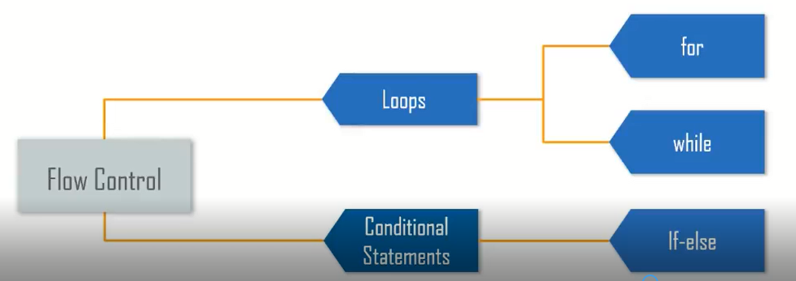
07. Flow Control
Parts of the code where the sequence must alter flow control comes to the rescue.

Slide 76
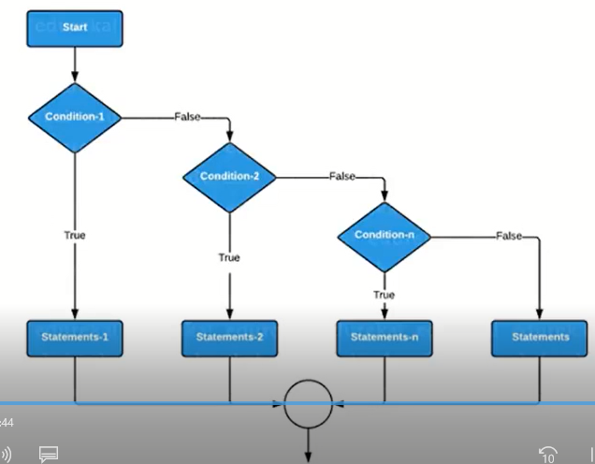
Conditional statements
Conditional Statements in python are if-else statements.
This is a simple if-else ladder
If-else can be within other if-else conditions called as nested conditions.

Slide 77
If-else Statements
Example #1
    a=10
    b=15
    if a==b:
    print('They are equal')
    elif a>b:
    print('a is larger')
    else:
    print('b is larger')
Example #2
  # nested if-else statements
  n=int(input("Enter a number :"))
  if n>=0:
  if n==0:
  print("Entered number is Zero!")
  else:
  print("Entered number is positive!:")
  else:
  print("Entered number is negative!")

Slide 78
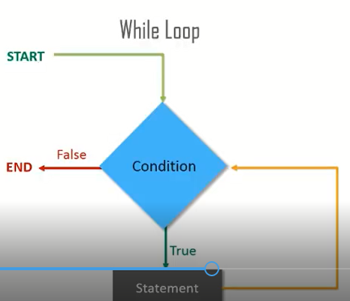
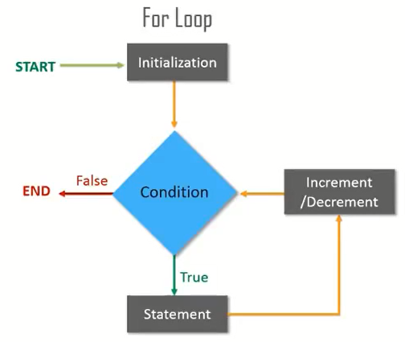
Loops
Loops are used when we want to execute a certain set of statements for different inputs several times.
.

Slide 79
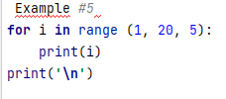
For Loop
Example #2
numbers=[1,2,3,4,5,6,7]
sum_of_elements=0
for i in numbers:
sum_of_elements+=i
print(sum_of_elements)
Example #4
  for i in range(3,7):
  print(i)
  print('\n')
Example #1
#Simple for loop
basket_of_fruits=['Apple','Orange','banana','pinapple']
for fruit in basket_of_fruits:
print(fruit)
Example #3
for i in range (10):
print(i)
print('\n')

Slide 80
Example: for with else loop
#for with else loop
cakes=[‘pineapple,’banana’s,’ blackberry']
for cake in cakes:
print(cake)
else:
print('No more cakes left to eat')

Slide 81
While Loop Example
# while loop
second=10
while second>=0:
print(second,end='->')
second-=1
print('Blastoff')
  counter=0
  while counter<3:
  print('Hello')
  counter=counter+1
  else:
  print('why you are not reprying!')

Slide 82

Nested loop
Output
#nested loop
count=1
for i in range(10):
print(str(i)*i)
for j in range(0,i):
count=count+1

Slide 83
08. What is Functions?
Functions provide a way to break problems or processes down into smaller and independent blocks of code that are run whenever called.
It is usually called by its name when its tasks need execution.
You can also pass values to it or have it return results to you.
Functions manage the inputs and outputs in computer programs.
main code is also a function, just a very important one at that.
Every other function is logically aligned and maintained to functionally execute from your main code.
But, if the function has not been defined previously, you’ll just have to define one yourself before using it.
So, to call a Python function at any place in your code, you’ll only have to use its name and pass arguments in its parentheses if any.

Slide 84
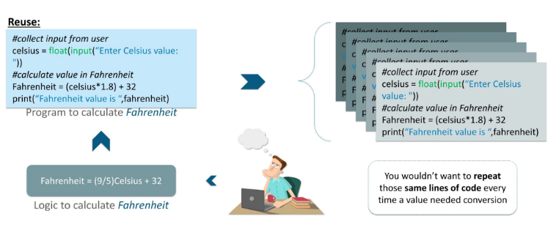
Why use a function
Because,
reduce redundancy,
increase readability, and
reusable code that is used to perform some task.
reduces lines of code and even makes debugging easier
Example: loo at this picture

Slide 85
def’ keyword
To define a Python function,
  you’d have to use the ‘def’ keyword before the name of your function and add parentheses to its end, followed by a colon(:).
Python uses indentation to indicate blocks instead of brackets to make codes more readable.
Functions are tasks that one wants to perform:
Syntax:
def function_name():
‘’’ this function does’’’
pass
Note: The rules for naming a function are the same as naming a variable.

Slide 86
The following are the different types of Python Functions:
  Built-in Functions
  User-defined Functions
  Recursion Functions
  Lambda Functions
Types of Python Functions

Slide 87
i. Built-in Functions
  enumerate() function
  format() function
  getattr() function
  id() function
  len() function
  map() function
  min() function
  pow() function
  setattr() function
  sorted() function
  type() function
  Etc.
Is functions that are always available for use.
Python has n numbers of the library.
Some example,
  print() function
  abs() function
  all() function
  ascii() function
  bool() function

Slide 88
Definition: Returns the absolute value of the given number.
Syntax: The syntax of abs() method is:
abs(num)
Parameters: The abs() method takes a single argument:
num – A number whose absolute value is to be returned.
The number can be:
  Integer, floating number, complex number
Example
# random integer
integer = -20
print('Absolute value of -20 is:', abs(integer))
#random floating number
floating = -30.33
print('Absolute value of -30.33 is:', abs(floating))
abs() Function:

Slide 89
all() Function:
Definition:
Returns True when all elements in the given iterable are true. If not, it returns False.
Syntax:
all(iterable)
Parameters: takes a single parameter:
iterable –
  Any iterable (list, tuple, dictionary, etc.) which contains the elements
Example
# all values true
l = [1, 3, 4, 5]
print(all(l))
# all values false
l = [0, False]
print(all(l))
# one false value
l = [1, 3, 4, 0]
print(all(l))
# one true value
l = [0, False, 5]
print(all(l))
# empty iterable
l = []
print(all(l))

Slide 90
ascii() function
Returns a readable version of any object(Strings, Tuples, lists, etc)
Syntax: ascii(object)
Parameters:
  The ascii() method takes an object (like strings, list etc).
x=ascii(“My name is:”)
Text = 'Python is interesting'
print(ascii(Text))
otherText = 'Pythön is interesting'
print(ascii(otherText))
print('Pythn is interesting')
Example

Slide 91
bool() function
Returns the Boolean value of a specified object.
Syntax: bool(object)
Example: x=bool(l)
Takes a collection(e.g. a tuple)and returns if as an enumerate object.
Syntax: enumerate(iterable, start)
Example:
X=(‘apple’, ’banana’, ’orange’)
Y=enumerate(x)
enumerate() function

Slide 92
len() function
Returns the number of items in an object
Syntax: len(object)
Example:
my_list=“Hello”
x=len(my_list)
Prints the specified message to the screen, or other standard output devices.
Syntax: print(object(s),separator=separator, end=end, file=file)
Example: print(“Hello”)
Print() Function

Slide 93
getattr() Function:
returns the value of the named attribute of an object.
If not found, it returns the default value provided to the function.
Syntax: getattr(object, name[, default])
Parameters
  The getattr() method takes multiple parameters:
  object – object whose named attribute’s value is to be returned
  name – string that contains the attribute’s name
  default (Optional) – value that is returned when the named attribute is not found
class Person:
age = 23
name = "Adam"
person = Person()
print('The age is:', getattr(person, "age"))
print('The age is:', person.age)
Example

Slide 94
ii. User-Defined Functions
Is functions that we define ourselves to do a certain specific task
If we use functions written by others in the form of the library, it can be termed as library functions.
So, our user-defined function could be a library function for someone else.
Syntax
  def function_name(argument1, argument2, ...) :
  statement_1
  statement_2
  ....

Slide 95
Advantages of user-defined functions
helps to decompose a large program into small segments which make the program easy to understand, maintain and debug.
If repeated code occurs in a program.
The function can be used to include those codes and execute when needed by calling that function.
3. Programmer working on a large project can divide the workload by making different functions.

Slide 96
Example #1: the use of user-defined functions
def add_numbers(x,y):
  sum = x + y
  return sum
  num1 = 5
  num2 = 6
  print("The sum is", add_numbers(num1, num2))
Output
    Enter a number: 2.4
    Enter another number: 6.5
    The sum is 8.9

Slide 97
Example #2: Program makes a simple calculator that can add, subtract, multiply and divide using functions
# This function divides two numbers
def divide(x, y):
return x / y
print("Select operation.")
print("1.Add")
print("2.Subtract")
print("3.Multiply")
print("4.Divide")
# Take input from the user
choice = input("Enter choice(1/2/3/4):")
num1 = int(input("Enter first number: "))
num2 = int(input("Enter second number: "))
if choice == '1':
print(num1,"+",num2,"=", add(num1,num2))
elif choice == '2':
print(num1,"-",num2,"=", subtract(num1,num2))
elif choice == '3':
print(num1,"*",num2,"=", multiply(num1,num2))
elif choice == '4':
print(num1,"/",num2,"=", divide(num1,num2))
else:
print("Invalid input")
# This function adds two numbers
def add(x, y):
return x + y
# This function subtracts two numbers
def subtract(x, y):
return x - y
# This function multiplies two numbers
def multiply(x, y):
return x * y

Slide 98
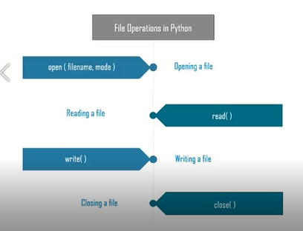
08. File handling
Python provides methods to handle files where we can read and write data into it.
Steps:
  Open a file
  Perform operations
  Close file
You need to make sure that you close the file to avoid damaging data in the file.
.

